Slide 1
Last Lecture! You made it
Reminders
Course Evaluations
Assignment 3: Due tomorrow (Dec 2nd)
Course Review!
Practice Exam Questions ☺
Note: please do not make conclusions about your exam based on these problems
*Not an exhaustive representation of important topics in this bank of problems

Slide 2
High-Level Topics
Java Basics
Making, running with JVM, and compiling java programs
Primitive vs non-primitive data types
Casting
Point of entry for every Java program (main method)
OOP
References/addresses vs objects themselves
Defining vs instantiating a new variable
Classes – attributes, constructor, this(), methods, overloading, super()
Protection/encapsulation
Variable scope, static
Built-In Arrays
Inheritance – only 1 parent, polymorphism, abstract classes, composition
UML Diagrams

Slide 3
High-Level Topics
JavaDoc
Syntax, Tags,
UnitTesting – Junit
Interfaces
public interface vs implements
Observer/Observable
Generics
ArrayLists
GUIs!
JavaFX (not Swing!)
Structure of a JavaFX application (extends Application, Stage, Scene, root node, start())
EventHandler (often used in conjunction with Observer/Observable)
SCRUM workflow

Slide 4
High-Level Topics
Git/version control
Cloning (checking out a new repo)
Pulling
Add, commit, push
Branches, merge conflicts
Design Patterns
Observer/Observable
MVC
Factory
Iterator, Singleton, Strategy, Command
Composite, Builder, Visitor
SOLID principles

Slide 5
High-Level Topics
I/O
Streams: Byte, Character, and Buffer Streams
Console vs File I/O
Regular Expressions
Be familiar with various symbols
How to build patterns
Using them in Java to return true/false
Compiling a regex – using RegEx groups to parse text
FSMs
FSMs are the engine of RegExs
Decomposing a computation/algorithm into a set of finite states (and transitions)
Floating Point Error
Converting between Base 10 vs Base 2 number systems
Scientific Notation
Floating point error -> having a finite space to store information
Cautions while doing arithmetic with stored numbers
IEEE 754 32- and 64-bit standards

Slide 6
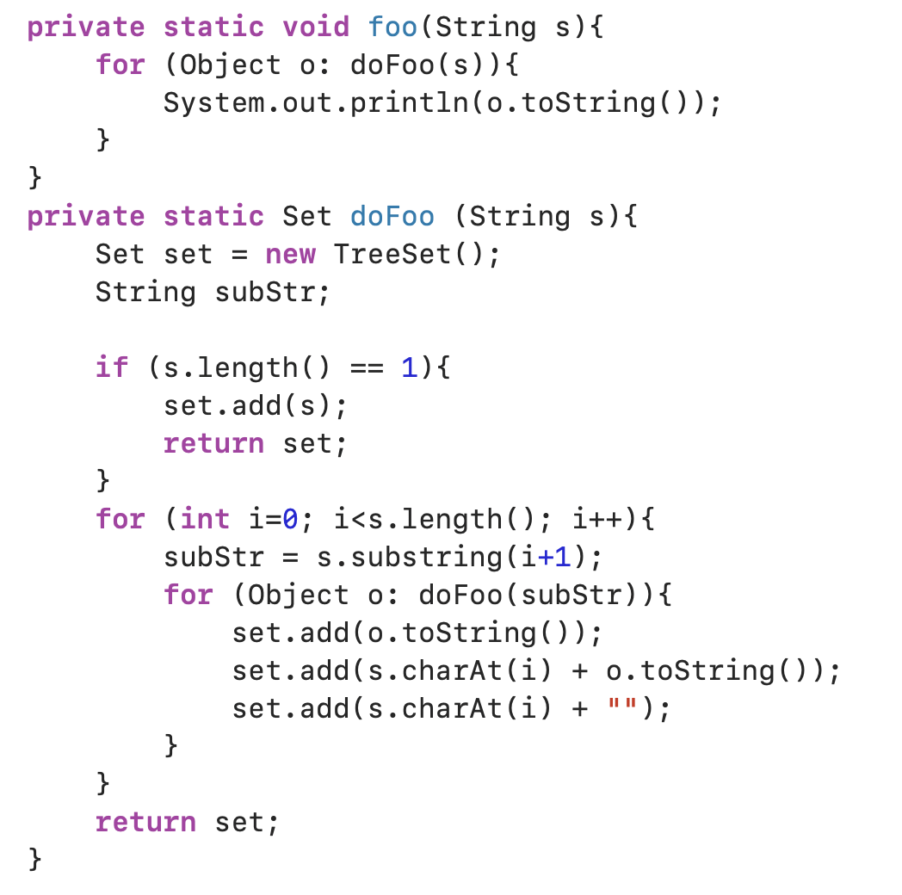
Practice Question 1
What does the following code do?

Slide 7
Practice Question 2a
RegEx | String | Match (Yes/No)
a*bc | bcaaabc
a*bc$ | bcaaabc
cb*a*bc$ | bcaaabc
^.*,.*,.*,.*$ | Hi, mom, I'm home, for good, now
\s.*\s | Please wipe your feet

Slide 8
Practice Question 2b
Write a regular expression to return true iff all numeric values, are prefixed with a “$” sign.
Sample: “the price is $345.”
Note that the numeric values can be positive integers (e.g. 40), as well as floating point numbers with two precision numbers (e.g. 567.34)
Now rewrite the regular expression so that you can extract the number following the “$” sign using a group.

Slide 9
Practice Question 3
Give a brief overview of the Scrum process. You may use diagrams if you think it would help covey information.
Be sure to include information about the project milestones and the sprints

Slide 10
Practice Question 4a
Which design pattern is best used to solve the following problem description: “I want a single method getAnimal() that can create and return different types of animal objects according to a string parameter, e.g., getAnimal(“Dog”) returns a new Dog object, and getAnimal(“Cat”) returns a new Cat object, etc.”

Slide 11
Practice Question 4b
Which design pattern is best used to solve the following problem description: I have a Matrix class that is implemented using a 2D array, and I want to be able to print all elements in the matrix in the following way: for (Integer x : mtx) {
// mtx is a Matrix<Integer> object
System.out.println(x);
}

Slide 12
Practice Question 4c
Which design pattern is best used to solve the following problem description: The user can easily switch between displaying a student list by student number, utorid or last name order.

Slide 13
Practice Problem 5
How does Java store the resulting value after this line of code is run? float num = 11.0/3;

Slide 14
Practice Problem 6
Create an FSM (both the diagram…circles and arrows and then code it!) to rrecognize whether a string is a valid command sequence to control a virtual robot. A valid command sequence must follow these rules:
The robot must start in the IDLE state.
The first command must be "START".
After "START", the robot may receive any number of movement commands:
"LEFT"
"RIGHT"
"FORWARD"
"BACK"
The command sequence must end with "STOP".
No other commands are allowed.
The FSM must read commands one at a time from a list and decide if the entire sequence is valid.
Valid: START, FORWARD, FORWARD, BACK, LEFT, STOP
Invalid: “START, FORWARD”, “START, START, STOP”, “START, JUMP, STOP”

Slide 15
Good Luck Everyone!
It’s a pleasure teaching everyone this past semester ☺

